Slide 1

Paleetu Assignment (22-10-2021)
By v Venkata sree harsha

Slide 2
CONTENTS
About API
About Open Banking
Understanding Of WSO2 Open Banking software
Choreo (Low-Code Platform)
Comparison Of WEM With Choreo

Slide 3
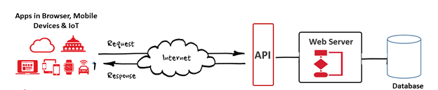
API (Application Package Interface)
APIs are a set of functions and procedures that allow for the creation of applications that access data and features of other applications, services, or operating systems.
Good APIs make it easier to develop a computer program by providing all the building blocks, which are then put together by the programmer
The API is not the database or even the server; it’s the code that governs the access point(s) for the server

Slide 4
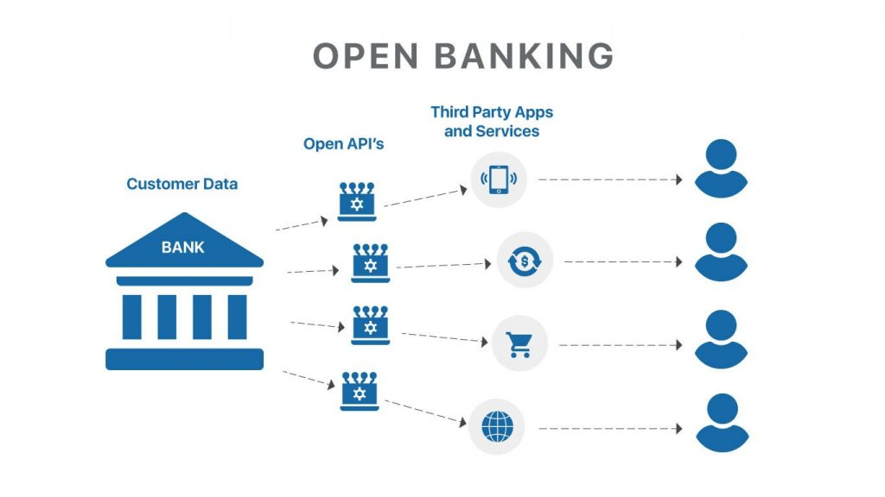
OPEN BANKING
Open banking, also known as open bank data, is a banking practice that allows third-party financial service providers to access consumer banking, transaction, and other data from banks through APIs.
Open banking allows consumers, financial institutions, and third-party service providers to use the network of accounts and data across institutions. Customers must agree to share their data by checking a box next to the 'terms of service' screen on the app. APIs of third-party providers can get the access to the customer data.
Examples of third-party service providers are: Yolt , Transfer Wise, Clear Score, 9 Spokes, Bottom line, Credit Ladder etc…

Slide 5

WSO2 BANKING SOFTWARE
Open banking is an established trend in the banking industry
Beyond compliance, it enables banks to deliver personalized experiences faster , create new higher-value revenue streams, and cut costs
WSO2 helps banks to secure ongoing compliance and quickly explore commercial open banking ahead of the competition

Slide 6
Functionalities Of WSO2
Secured API invocation - With comprehensive support of OAuth2, OpenID Connect, and eIDAS certificate validation.
Predefined API templates - That support Open Banking UK, The Berlin Group, and Consumer Data Standards Australia API specifications.
Comprehensive security capabilities - Such as Strong Customer Authentication with Fraud Detection and Consent Management.
Easily Pluggable - Easy integration with core banking systems.
Third Party Provider Onboarding - A thorough verification before connecting Third Party Providers with the banks.
API analytics and Transaction Risk Analysis - Dashboards for trend analysis and alerting incidents.

Slide 7
Choreo (Low-Code Platform)
Choreo is a digital innovation platform that allows you to develop, deploy, and manage cloud-native applications at scale. Its AI-assisted, low-code application development environment simplifies creating services, managing APIs, and building integrations while ensuring best practices and secure coding guidelines.
Core Benefits are: Integration Creation, Microservice Building, API Management, Run Professional DevOps, Build an API Marketplace
It deeply traces your executions from the code statement level to the machine it runs in. It presents all observability data and logs aligned in the same timeline, with end-to-end flame graphs providing all you need to troubleshoot your applications.

Slide 8
Comparison Of WEM & Choreo
WEM | CHOREO
UI is normal and decent | UI is Attractive & Fast
Having Less API Integrations compared to choreo | Having good number of API Integrations
Doesn't have Smart Code Assistance | Smart Code Assistance is integrated
Doesn’t have Anomaly Detection | Anomaly Detection is present which helps in tracking of transfer of data ( Throughput & Latency)
Less Support compare to choreo | Having good support and good platform partners compared to WEM
Kubernetes is not supported | Kubernetes is supported

Slide 9
Thankyou

